Slide 1

Health Insurance
Provider Database
By,
Lakshmi Durga Panguluri
Ananya Chowdhury
Amrita Prabhu
Group 3

Slide 2
Introduction
Health insurance provider provides insurance to its subscribers and pays for medical expenses in exchange for premiums. The monthly or annual premium is paid and the insurance providers contracts with the hospitals to provide benefits to its members at a discounted rate.
Health Insurance providers maintain a database for the large data they handle of their Subscribers.
It is also essential to maintain details of the plans that the Subscribers are Subscribed to.

Slide 3
Objective
Health Insurance providers provide Insurance plans to the Subscribers.
Subscribers takes services from the Hospitals and accordingly bills are generated.
Subscribers claims from Insurance providers their money based on the plans they are subscribed to.
The Insurance provider pays coverage amount based on their individual plans.

Slide 4
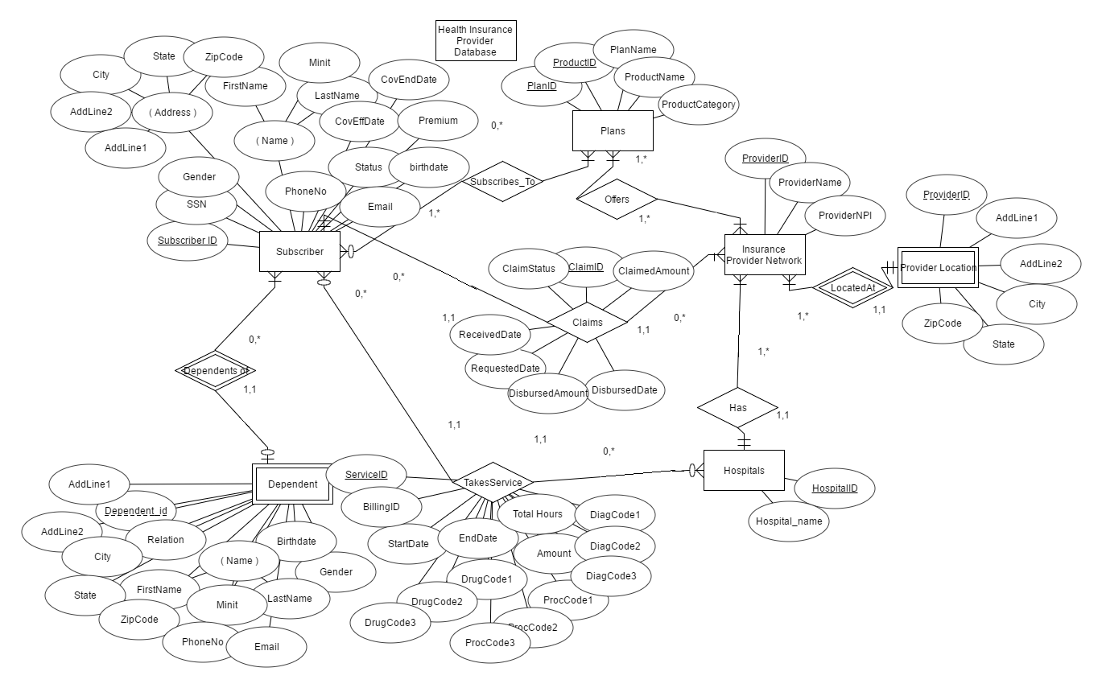
ER Diagram:

Slide 5
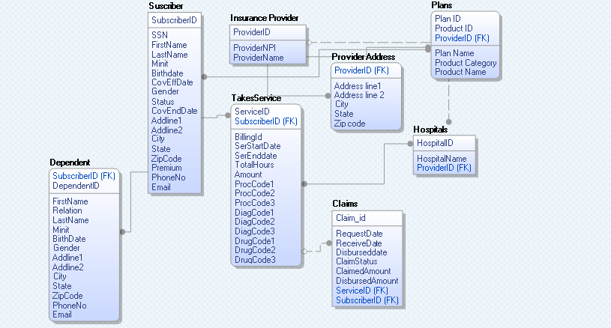
ER Model:

Slide 6
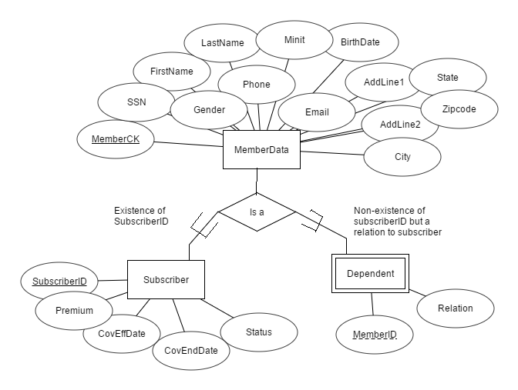
EER Diagram

Slide 7
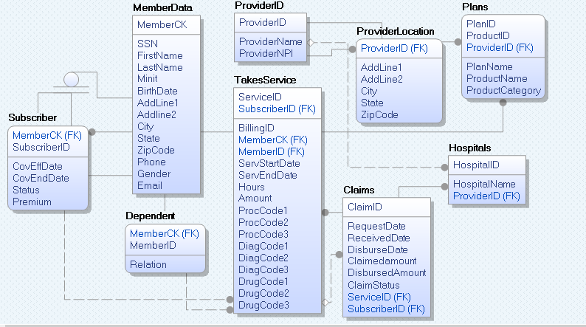
Data Model- Logical layer

Slide 8
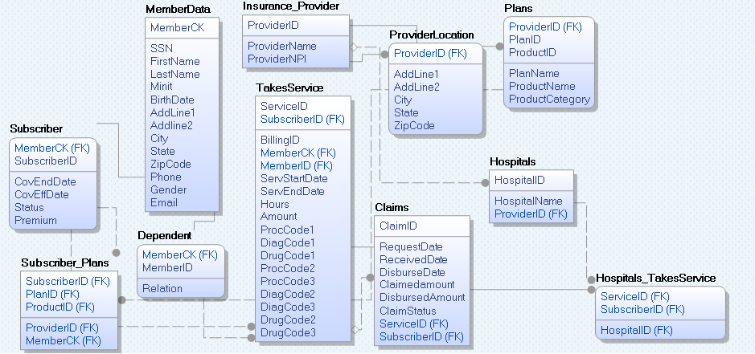
Data Model- Physical layer:

Slide 9
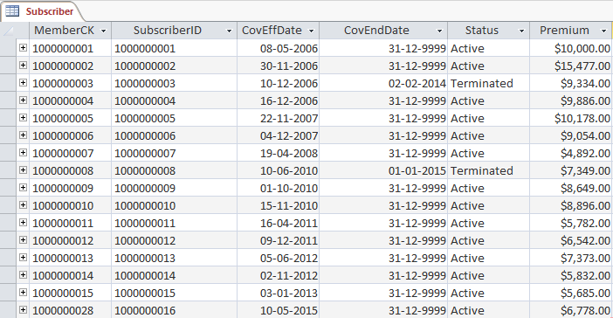
SQL Implementation
create table Subscriber (MemberCK varchar(10) NOT NULL, SubscriberID varchar(10) NOT NULL, CovEffDate DATE, CovEndDate DATE, Status varchar(25), Premium varchar(10),
PRIMARY KEY (SubscriberID),
FOREIGN KEY (MemberCK) REFERENCES MemberData(MemberCK));

Slide 10
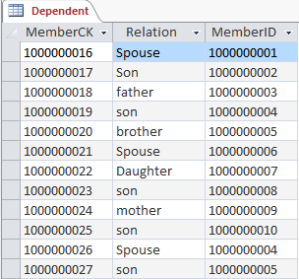
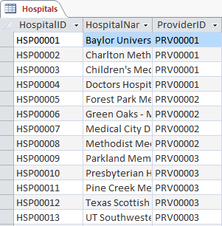
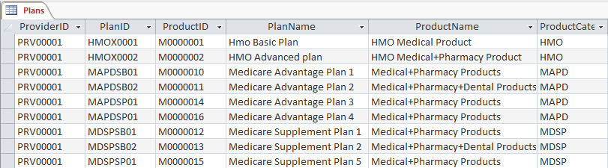
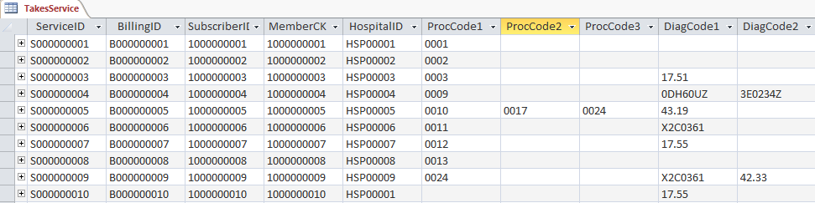
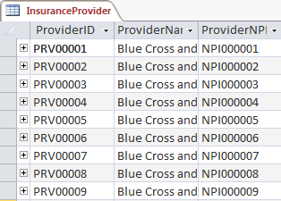
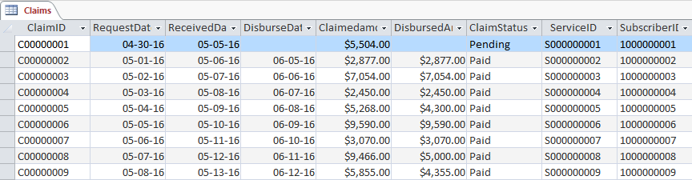

Slide 11

Validation
Simple Query:
Find the Address, City, State, ZipCode of the insurance provider 'Blue Cross and Blue Shield of NewYork'.
SELECT AddLine1, AddLine2, City, State, ZipCode
FROM ProviderLocation AS p, InsuranceProvider AS i
WHERE p.ProviderID=i.ProviderID and i.ProviderName='Blue Cross and Blue Shield of NewYork';

Slide 12

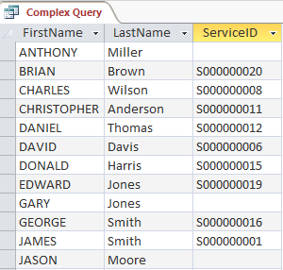
Complex Queries:
Find the Provider ID and the number of Subscribers who took services where the provider is located in Texas.
SELECT count(SubscriberID) AS No_of_Subscriber FROM TakesService WHERE HospitalID in (select HospitalID from Hospitals where ProviderID in (select ProviderID from ProviderLocation where State='TX'));
Find all the Member names and the serviceID taken by them.
select m.FirstName, m.LastName, s.ServiceID
from MemberData m LEFT JOIN TakesService s
on m.MemberCK=s.MemberCK
GROUP BY m.FirstName, m.LastName, s.ServiceID, m.MemberCK;

Slide 13
Conclusion
The Data model is created using ERWIN and database is created using MSACCESS.
One Generalization and one Specialization has been defined.
13 entities/tables have been created in total with respective constraints based on the Physical layer model
of the ERR diagram.
The database has been validated by creating 10 queries which consists of 5 simple and 5 complex ones.

Slide 14
Thank You!
Thank You

